Slide 1
Computer Architecture W4D2: Branch Prediction & Superscalar
Jian Weng
Computer Science
CEMSE, KAUST

Slide 2
Care! Downstream modules hurt timing!
What should you do to bypass a branch result?
Combinational?
Sequential?
IF
ID
EX
MA
WB

Slide 4
Characterization
Assumption: All the architectures discussed are pipelined.
Instead of saying Tomasulo or other algorithms, I will characterize:
In-/out-of-order
(Non-)Speculative
Single/Multi-issue

Slide 5
Roadmap
Why do we have branch predictor?
How is it achieved?

Slide 6
Branches
Control hazard: Before executing this instruction, PC is not determined
Why is it bad?
2-cycle bubbles
bnez t1, △
F D X M W
? ? F D X M W
bne t1, x0, △

Slide 7
Control Hazard: Solution
Fast branch: Execute the branch in ID
+ It seems to know the result one cycle earlier
- More complicated decoding for comparison and addition
- Decoding sometimes takes more than you expect
bnez t1, △
Look out! This △ is a relative address!
5-stage pipeline is just 5 things to do in instruction execution.
The granularity of explanation is determined by understandability.

Slide 8
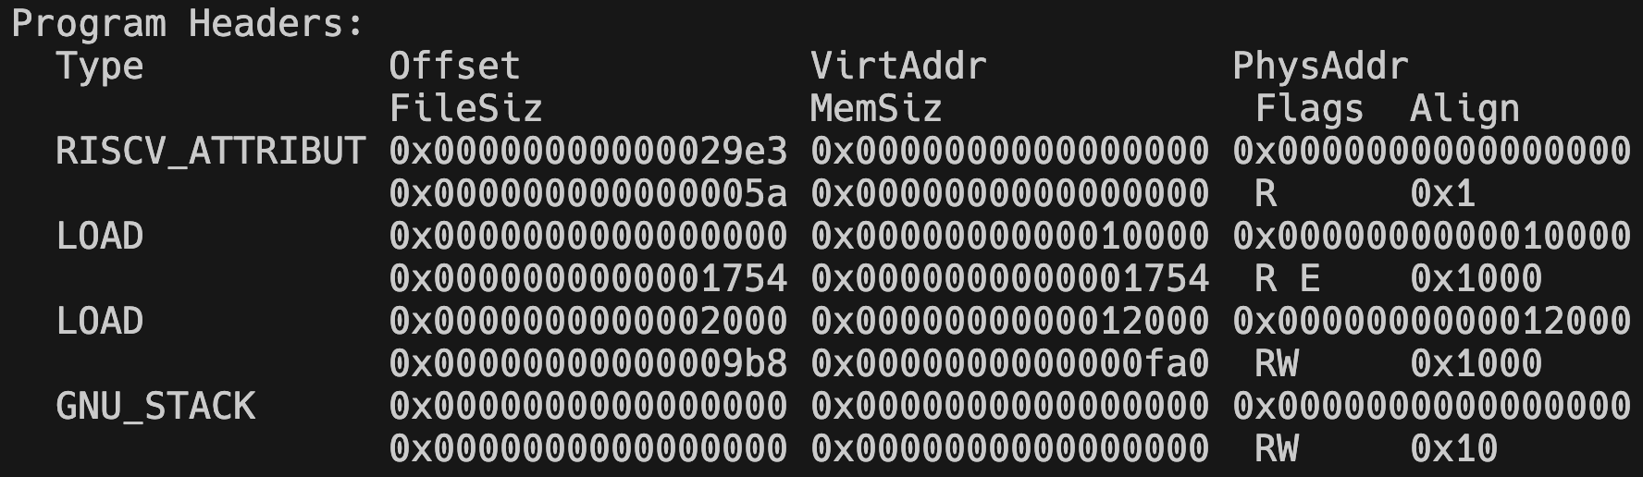
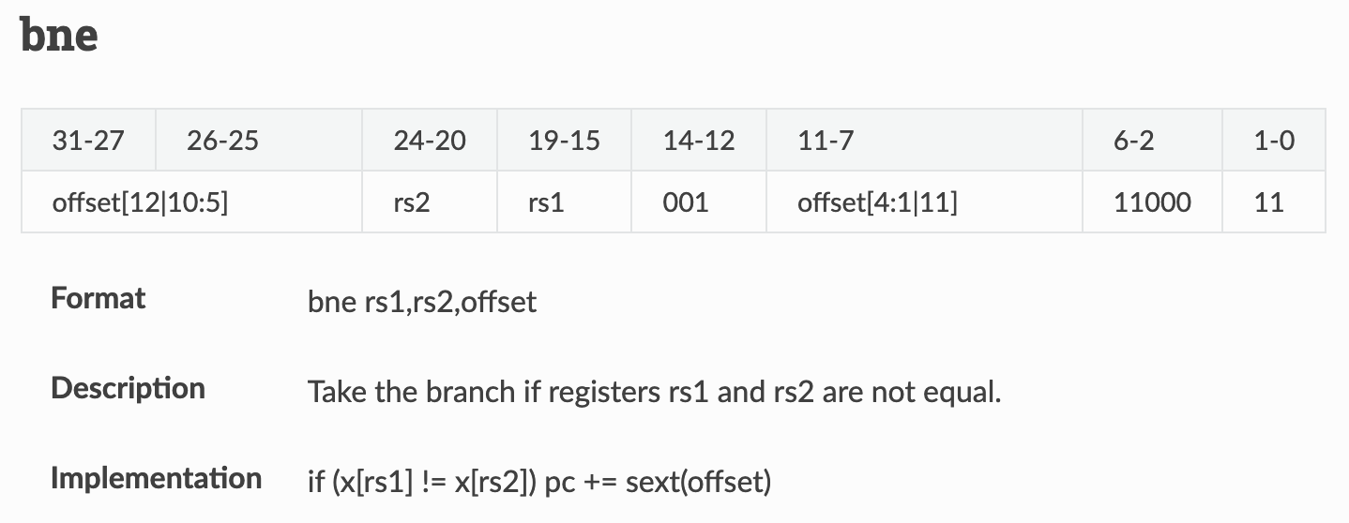
Recap: Aligned Code Loading
Recap: Branch Encoding
12-bit encoding
[-2048, 2047]
Within an aligned page

Slide 9

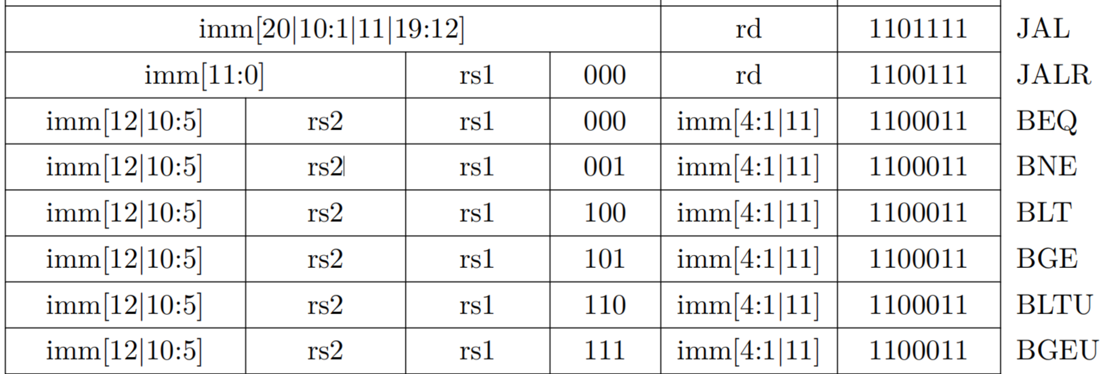
Recap: Branch Encoding
MSB the same location
Critical for sext!
[10:5] the same location
Switch is too expensive

Slide 10
Control Hazard: Trends
Trends to have more stages for better frequency
486 (1989): 5
Pentium (1993): 7
Pentium II (1997) / III (1999): 12
Pentium 4 (2000-2007): 22
Nehalem (2008): 20-24
Haswell (2013) / Skylake (2017) / Cooper lake (2020): 14-19
More stages → more stages on decoding → more delays on ctrl hazard

Slide 11
Solution (CONT’D)
Delayed Branch: Branching takes effect one insn. Later
MIPS adopts this and regrets
Not a big win compared to today’s CPU
Not always finding such an instruction
bnez t1, △
addi t2, t2, 1
sub t3, t3, t4
This instruction is STILL part of last BB
This instruction is NOT

Slide 12

(1) It’s better to be wrong once in a while than to be right all the time.
Solution - PACT’18: Keynote

Slide 13

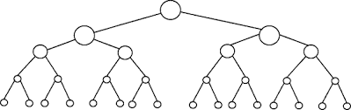
Impossibility of exploiting ILP: [c. 1972]
Flynn bottleneck
“..Therefore, we must reject the possibility of bypassing conditional jumps as being of substantial help in speeding up execution of programs.
In fact, our results seem to indicate that even very large amounts of hardware applied to programs at runtime do not generate hemibel (> 3x) improvements in execution speed.”
Riseman and Foster, IEEE Trans. Computers, 1972

Slide 14


Exploiting ILP [Fisher c.1982]
Key idea:
Branch speculation
Backup/re-execute if prediction is wrong
Dynamic branch prediction [Smith,Patt]
Infallibility is for popes, not parallel computing
Broader lesson:
Runtime parallelization: essential in spite of overhead and wasted work
Compile-time parallelization: only part of the solution to exploiting parallelism (see Itanium)

Slide 15
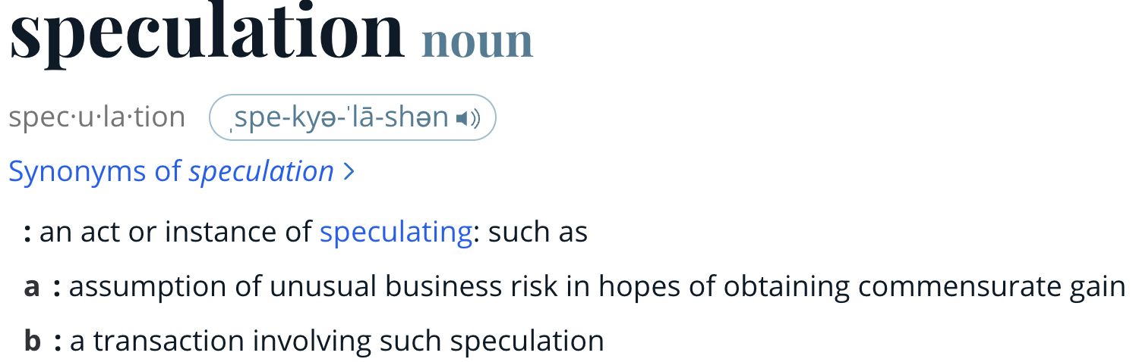
Solution: Branch Prediction
Speculative Execution
Guess what to do
Execute the instruction before the results

Slide 16
Branch Prediction (CONT’D)
Guess what to do
Correct Speculation
Save two bubble cycles
Incorrect Speculation
Roll back executions.
Execution time no penalty.
No worse than 2 stalls
F D X M W
? ? F D X M W
F D X M W
F D X M W
F D X M W
F D X M W
F D X M W

Slide 17
Misprediction: Recovery
Incorrect Speculation
F D X M W
F D X M W
F D X M W
Flush the incorrect instructions
Key Idea: Stop the execution before committing to states
F D X M W
F D - - -
F - - - -
F D X M W
X→D/X: Override with noop
X→F/D: Override with noop
X→F: Tell the right inst to fetch

Slide 18
Paradox: When to predict?
More stages → more stages on decoding → more delays on ctrl hazard
We will know it is a branch late
We will invoke a prediction late
Proposed Solution: BTB
Branch Target Buffer

Slide 19
BTB: Branch Target Buffer
Buffer: It is an on-chip memory
On-chip memory/SRAM/Cache/$
Key difference
Register knows value immediately
SRAM knows value 1-cycle later
Fetcher requests from I-memory
Memory responses to Decoder
I$
BTB
IF
ID

Slide 20
Assassyn: Dealing w/ Memory
Recap: Callback function
This is useful for memory usage
Memory “pushes” data to the next stage
Calls its call back function.
x = async foo(1, 2) // A Promise returned
x.when(function (result) {
// use the returned value here.
})
foo will be done, but not immediately;
a promise is returned to use the result when ready

Slide 21
BTB: Branch Target Buffer (CONT’D)
A small cache LUT
Key: PC address
Value: Target PC
BTB
31:20
19:10
9:2
1:0
19:10
13:2
…
19:10
13:2

Slide 22
BTB: Branch Target Buffer (CONT’D)
Hit? It is a branch!
No hit? It is not necessarily not a branch
31:20
19:10
9:2
1:0
Associativity
19:10
13:2
Pentium 4:
2k Entries
4-way associative
…
19:10
13:2

Slide 23
BTB: Branch Target Buffer (CONT’D)
Aliasing?
It’s ok… At least it does not hurt the correctness
Entry Creation: By Execution
31:20
19:10
9:2
1:0
19:10
13:2
…
Note: this target address is the branch taken
19:10
13:2

Slide 24
BTB: Branch Target Buffer
Part I: Should I take the branch?
Applies to conditional branches
Predicts T/NT
Hard
Part II: If taken, where should I go?
For control transfers
Predict target PC

Slide 25
Branch Direction Prediction
Branch instructions are often “biased”
Biased: A likelihood to a specific direction
E.g. for-loop often takes branching
BHT: Branch History Table
31:20
19:10
9:2
1:0
19:10
1: T/N/…
Do what I did last time!
…
19:10
1: T/N/…

Slide 26
BHT can easily be messed…
Consider the code below
Actual i-branch: (T, T, N) x n
Prediction: _, (T, T, N) x n
TTNTTNTTNTTNT...
?TTNTTNTTNTTN...
for (j=0; j<n; ++j)
for (i=0; i<3; ++i)
// what ever
☹: Half of the correctness?

Slide 27
2-Bit Saturating Counters
Now, BHT entry has 4 states encoded in 2 bits.
I am confidently correct!
Did I do anything wrong?
Strong T
Weak T
Hmm. I am confident again!
Fine, I change my mind…
I am confidently correct!
Strong N
Weak N

Slide 28
2-Bit Saturating Counters (CONT’D)
Now BHT has 4 states encoded in 2 bits
TTNTTNTTNTTN...
TTtTTtTTtTTt...
Now we are 66.66% correct…
Slightly better…
Can we do even better?

Slide 29
2-Level Predictor: Correlated
Outcomes are correlated to its history
31:20
19:10
9:2
1:0
History Table
19:10
3: TTN
…
19:10
3: TTT
Prediction Table
2³-bit Pred
Look up

Slide 30
Design Decision 1: Global/Local BH?
Local Design: Each entry has its own history
31:20
19:10
9:2
1:0
19:10
3: TTN
…
19:10
3: TTT
Prediction Table
2³-bit Pred
Look up

Slide 31
Design Decision 1: Global/Local BH?
Global Design: Look up uses global register history
Global History Register
3: TTT
31:20
19:10
9:2
1:0
19:10
2³-bit Pred
…
19:10
2³-bit Pred

Slide 32
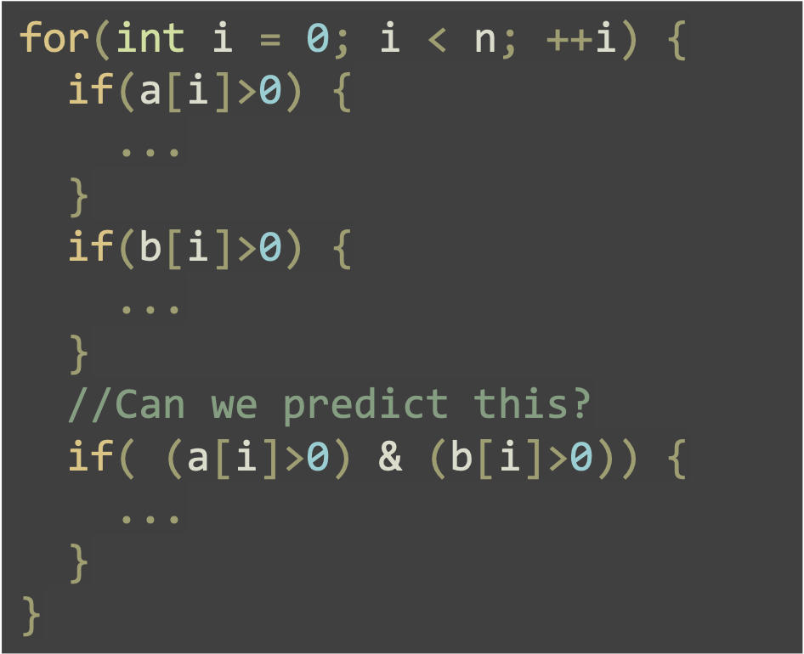
Design Decision 2: How many bits of history?
More bits → more history → better prediction
More bits → lower utilization
Some history never happen at all
Typically 8-12 bits of history

Slide 33
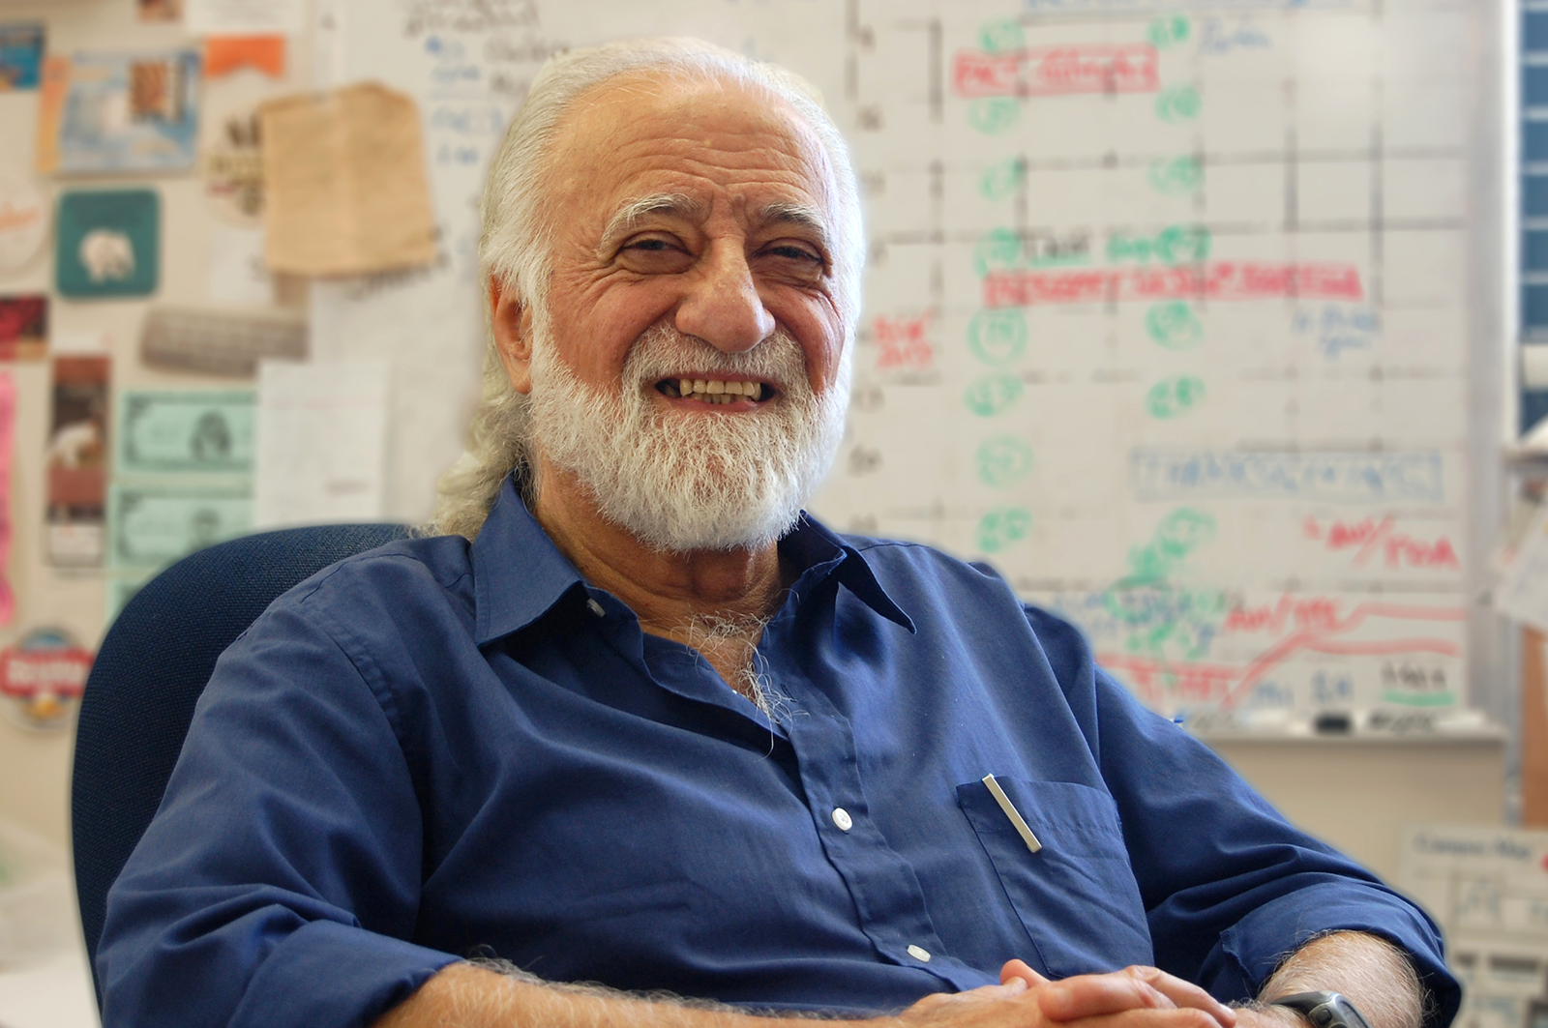
Correlated Predictor [Yale Patt et al. 1991]
He should have taught you some basic computer arch weeks ago (but not)
Uses to be the one with the most ISCA paper until 2019 (?)
But then his student Onur dominates

Slide 34
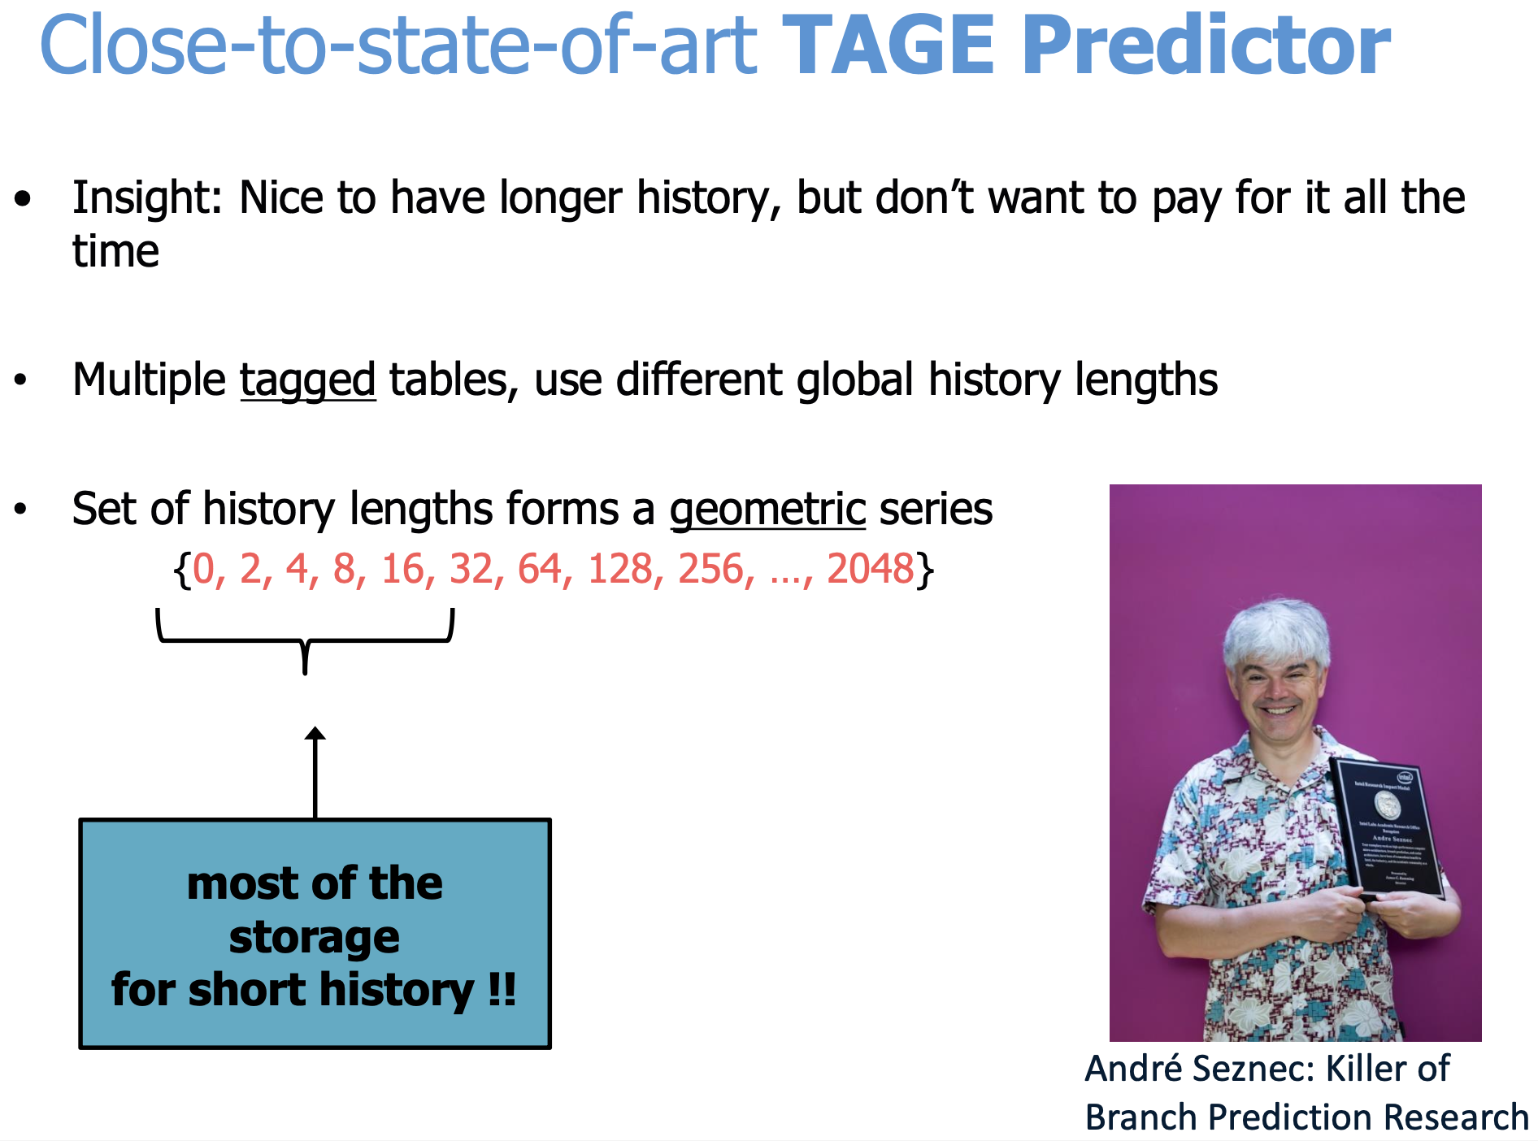

Slide 35
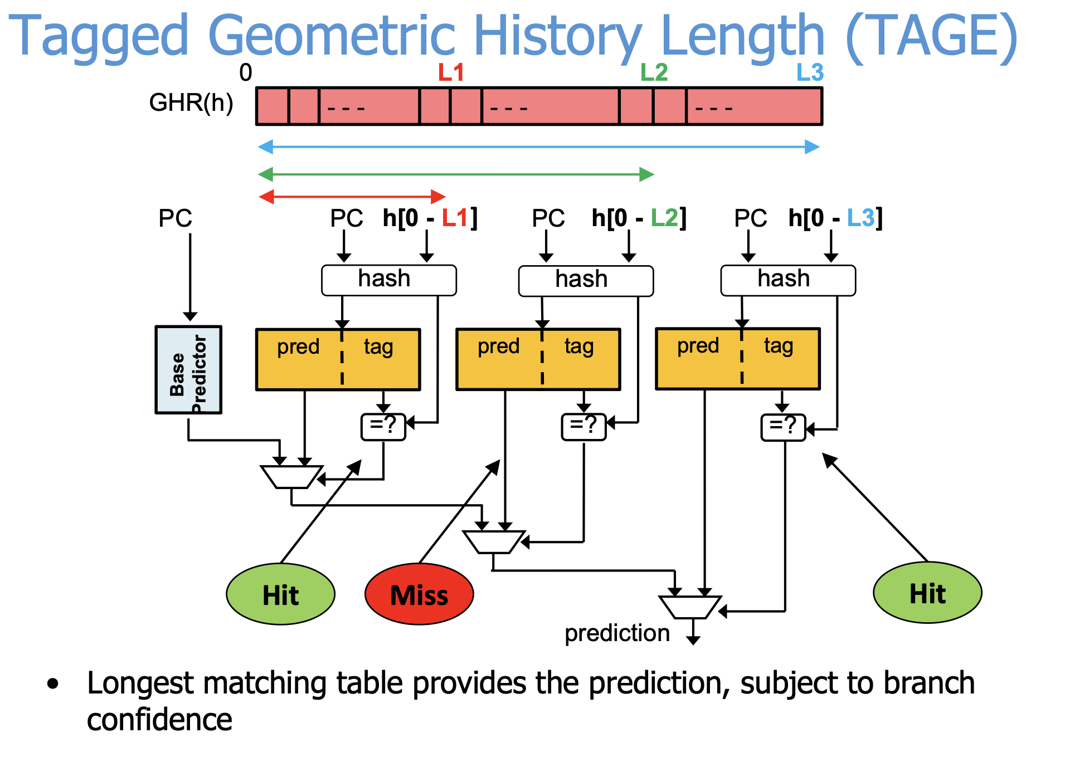

Slide 36
Wait… Did I miss something?
Part I: Should I take the branch?
Applies to conditional branches
Predicts T/NT
Hard
Part II: If taken, where should I go?
For control transfers
Predict target PC

Slide 37
PC Prediction: Return Address Stack
RAS tracks the call sequence
jal pushes PC+4 onto RAS
Prediction returns the top of RAS on return

Slide 38
Summary
Typical breakdown:
Branch 20%, Load 20%, Store 10%, Other: 50%
75% branches are taken
Prediction can achieve around 95% accuracy
No penalty? Yes and no.
Yes: No performance penalty, no worse than stalls
No: transistors are charged
J_{predict} + [(1-%_{mispredict}) * J_{exec}]

Slide 39
Characterization
Assumption: All the architectures discussed are pipelined.
Instead of saying Tomasulo or other algorithms, I will characterize:
In-/out-of-order
(Non-)Speculative
Single/Multi-issue

Slide 40
Multi-issue/Superscalar
Before
After
F D X M W
F D X M W
A single instruction each time.
F D X M W
F D X M W
F D X M W
F D X M W
Multiple instructions each time
(Ideal case)

Slide 41
Multi-issue/Superscalar
Before
Single fetch
Single decode
Single execution
Single MA
Single WB
IF
After
Multi-fetch
Multi-decode
Multi-execution
Multi-MA
Multi-WB
IF
ID
ID
EX
EX
MA
MA
WB
WB

Slide 42
Wider…
Wider fetch: It’s OK.
Typically cache line is 256-bit
256/32=8 instructions
Simple for RISC-like
What if X86 does not align?
Pad with noops
Wider decoder
Still RISC is simple
Wider operand validity
N² complexity
N-wide issue
N-wide reg read

Slide 43
Recap: Flattening Arrays
Dude, there is no high-dimensional arrays
int b[200][100]; // 2d array
// use array
b[i][j]
// flattened array use
((int*)b)[i*100+j];

Slide 44
Even Worse in Hardware 🤦🏻‍♀️
Dude, there is no “arrays” in hardware
logic a[32][31:0];
logic rs[5:0];
// read a[rs];

Slide 45
Even Worse in Hardware 🤦🏻‍♀️
Dude, there is no “arrays” in hardware
Reads are switches of selecting bits
logic a0[31:0]; logic a1[31:0]; ...
logic rs[5:0];
logic value[31:0];
if (rs == 5'0) value = a0;
else if (rs == 5'1) value = a1;
else if (rs == 5'2) value = a2;
// ...

Slide 46
Wider… (CONT’D)
Wider execution 🤯
Say, 4-issue, it is OK to have 4 sets of integer ALUs
Maybe? But div is expensive
Even worse, how about floating point div?
How about laning?

Slide 47
Wider… (CONT’D)
Wider execution 🤯
How about laning?
rs1
Decoder Lane 1
Executor ALU 1
rs2
rd
rs1
Decoder Lane 2
Executor ALU 2
rs2
rd
…
…

Slide 48
Wider… (CONT’D)
Wider execution 🤯
Wider bypassing
rs1
Decoder Lane 1
Executor ALU 1
rs2
rd
rs1
Decoder Lane 2
rs2
Executor ALU 2
rd
…
…

Slide 49
Wider…
Wider Register Writeback
Dude, there is no “arrays” in hardware 🤦🏻‍♀️
logic a[32][31:0];
logic rd1[5:0];
logic rd2[5:0];
@always(posedge clk) begin
if (we1) a[rs1] <= some0;
if (we2) a[rd2] <= some1;
end

Slide 50
Even Worse in Hardware 🤦🏻‍♀️
Synthesizer helps you though…
@always(posedge clk) begin
if (we1 & (rd1 == 0)) a0 <= some0;
else if (we2 & (rd2 == 0)) a0 <= some1;
if (we1 & (rd1 == 1)) a1 <= some0;
else if (we2 & (rd2 == 1)) a1 <= some1;
...
end

Slide 51
Summary
Not only operand validity check
It is almost everything in N×M-order of cost
Operand
Bypassing
Read
Write
Routing is N×M

